Slide 1

Port-o-matic IoT and Drones for Smart Ports
TM Forum {open}:hack, Nice France, May 14-16.
Joe Appleton (Southampton Solent University @joeapppleton18)
Jergus Lejko (Southampton Plent University)
Michael Sievenpiper (Southampton Solent University)
Marcin Wisniewski (Southampton Solent University)
Dr Craig Gallen (Open NMS UK cgallen@opennms)

Slide 2
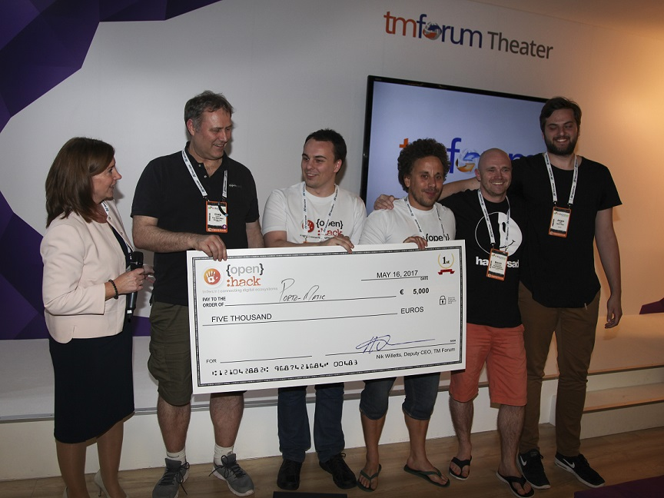
Winners TM Forum Open Hack Nice 2017
Joann O Brien (TM Forum), Dr Craig Gallen (Open NMS UK), Michael Sievenpiper (3rd yr. Student) , Joe Appleton (Lecturer Solent Uni) , Marcin Wisniewski(2nd yr. Student) , Jergus Lejko (1st yr. Student)

Slide 3
Southampton Port-o-matic Smart Port Platform
Port-o-matic
Is a platform bringing together shipping companies and ports
Southampton Port is the second largest in the UK
52,000 ships a year
The UK’s number one cruise port, which welcomes 1.7m passengers
Each cruise ship up to 6,000 passenger and crew
Contributes £1.23 billion to the UK economy
- API’s provided by:

Slide 4
Our Platform Solution
Single point for ordering and accessing port services
Service Catalogue
Easily discoverable services
Aggregation of 3rd part offers
Port services (Docking charges, Water, Electricity, Waste Water and Data Communications etc.)
Pollution charging (for running generators in port)
Measurements
Ship Side IoT devices Measuring Water, Electricity, Waste Water and Data consumption
Flying Drones measuring smoke emissions for pollution charging
Presentation
User Web Application to view, order and access services

Slide 5






System Architecture
Front End
Drone API
Charge API
GlassFish To Calculate
Drone Routes
Catalog and
Inventory API
OpenNMS API
To Store Data
In Cassandra NoSql

Slide 6
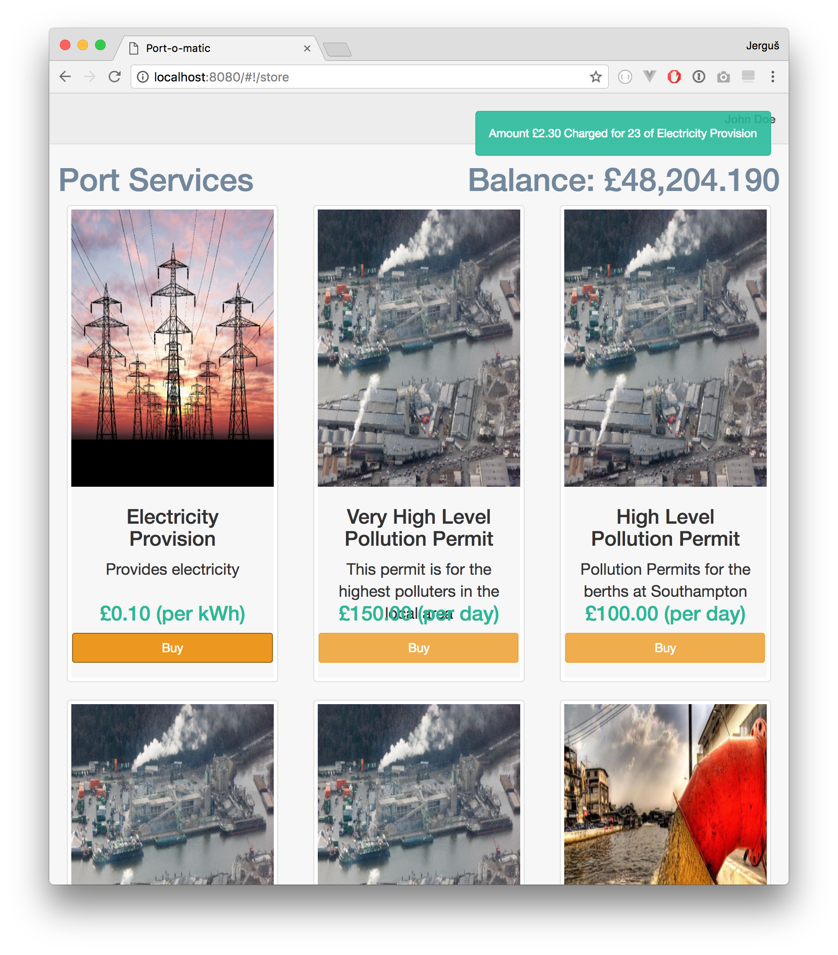
SalesForce & Huawei API integration
SalesForce Catalog
Pulled services
Their data/pricing
Huawei Charging & Balance API
Used to charge for services

Slide 7
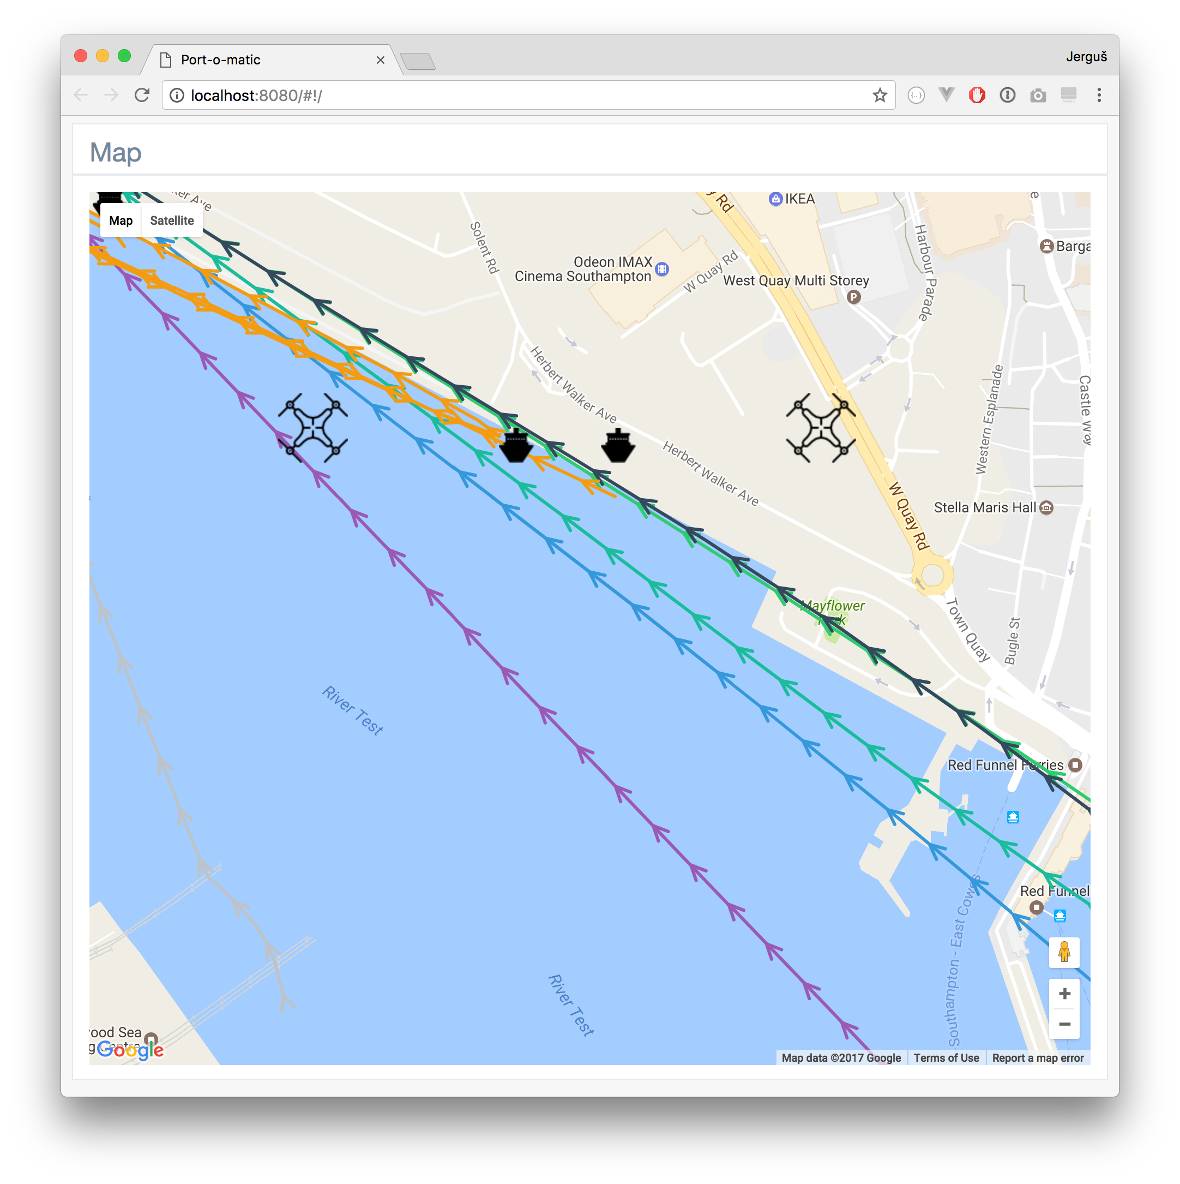
Vodafone Drone API integration
Real-time data mapping
Position, direction
API’s
TMForum Address API
Vodafone Drone API
Flight Control Algorithm
Automatic mission handling

Slide 8
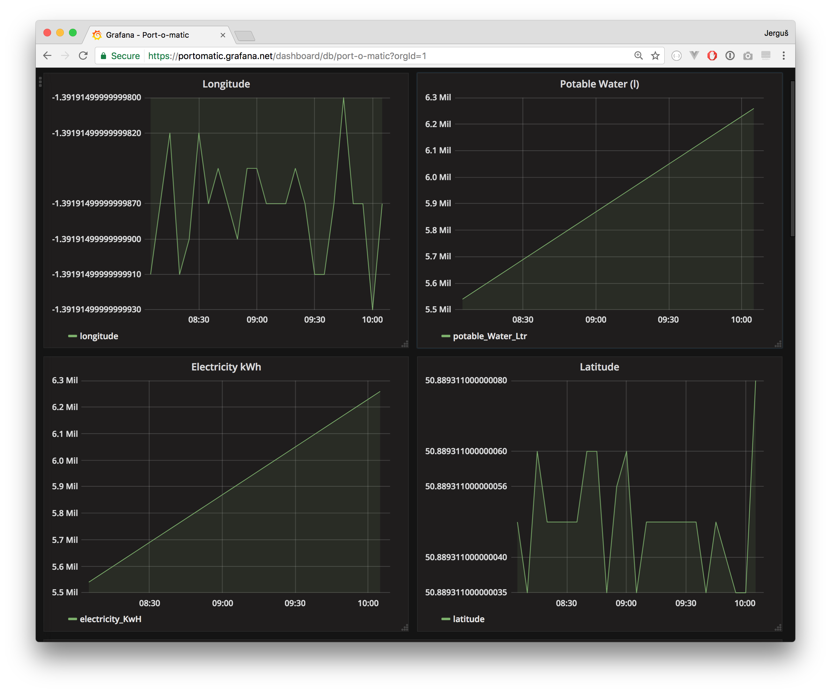
Grafana
Display of real time data from drones and metering devices
Grafana Measurements API
Cassandra
NoSQl
OpenNMS

Slide 9
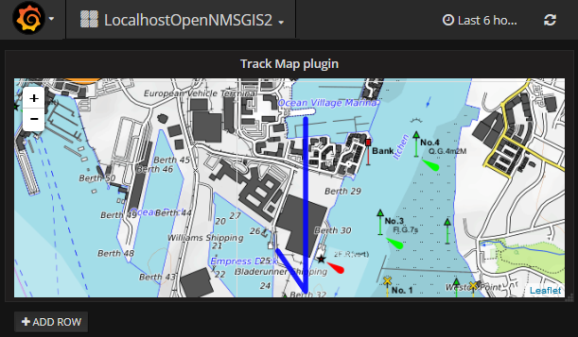
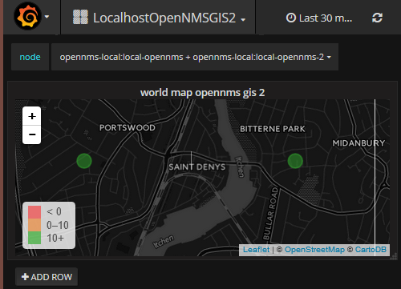
Grafana – Enhanced GIS Plugins
Grafana map plugins to display a path over time or values at coordinates
Code for plugins at
https://github.com/gallenc/grafana-track-map
https://github.com/gallenc/worldmap-panel
Cassandra
NoSQl
OpenNMS

Slide 10

Calculating Measurements
calculated drone path
double measuredCy; is the total measured concentration (μg/m3) at distance Dy;
double distanceDz; // Dz is the distance from the ship (m) at which concentrations are to be predicted;
double predictionCz = ((measuredCy) / (2.7171)) * (-0.5476 * Math.log(distanceDz)+2.7171);
x

Slide 11
Architecture
Cassandra
NoSQL
OpenNMS
Drone Controller
Grafana
VODAFONE DRONE API
Port IoT OpenNMS minions
Simulated ships and drones
Emission
Calculator
Mission Calculator
All code Open Source
See: https://github.com/gallenc/tmforumhack2017/tree/master/TMForumNice2017Hack
TMForum ADDRESS API
Address db

Slide 12
TM Forum {open}:hack, Nice France, May 14-16.
THANK YOU
QUESTIONS?

